Slide 1

Revisiting modern .NET for the FoxPro Interop Developer
Rick Strahl
West Wind Technologies
www.west-wind.com
www.west-wind.com/weblog
Session materials:
https://github.com/RickStrahl/VirtualFoxFest2021-FoxProRest

Slide 2








Rick Strahl
Big Kahuna & Janitor West Wind Technologies
Author and Speaker
Popular Blog: weblog.west-wind.com
ASP.NET Insider and MVP
Tools and Components
@RickStrahl
rstrahl@west-wind.com
weblog.west-wind.com

Slide 3
Why use .NET with FoxPro?
Extend FoxPro’s Reach
Add functionality otherwise not available
Easily accessible from FoxPro
Easy to create your own .NET code
Incrementally allows adding .NET to FoxPro for possible Migrations
Most popular services and APIs are exposed to .NET
System Functionality (Windows, APIs, Services)
Thousands of 3rd Party and OSS Libraries, APIs and Integrations
If it’s supported on Windows there likely is a .NET library for it!
. Modern .NET is different than old .NET
Easier to get started with
Tooling is built into a single installable SDK
Build, Test, Debug and Run from SDK and command line
Does not require Visual Studio or even Windows

Slide 4
.NET Framework or .NET Core?
.NET Framework: the old workhorse
Pre-installed with Windows, always available
Best choice for FoxPro
Version 4.8 is last version (no new features)
.NET Core: the new and shiny
Multi-platform (Windows, Mac, Linux)
High performance, focus of Microsoft’s .NET strategy
Not pre-installed, runtime install required
wwDotnetBridge supports .NET Core as of v7
FoxPro -> .NET
Prefer using full Framework as your default target (target net472)
Use .NET Core only if you have to interface with Core only components

Slide 5
FoxPro and .NET Interop
COM Interop
Built-in, relies on COM semantics
Requires specially registered components (regAsm)
Very few native components support direct COM Interop
Essentially only works with components you write
wwDotnetBridge
Open Source library with many features
Registration-less instantiation of .NET Components
Access to most .NET Components
Allows access to types/features not available through COM

Slide 6
Why do you need wwDotnetBridge?
It's free and Open Source
Hosted on Github: https://github.com/RickStrahl/wwDotnetBridge
Registrationless .NET Access
No COM registration required for .NET Instantiation
Hosts .NET runtime in FoxPro
Instantiate .NET Types directly
Direct access to most .NET types
Even types not exported or [ComVisible(false)]
Access features not supported by COM Interop
Access statics, value types, enums, generics
Call overloaded methods easily
Type Conversions available
Simplified Array handling with ComArray wrapper
Handle binary, GUIDs, numeric, enums via wrappers
Automatic DataSet to Cursor conversions

Slide 7
How wwDotNetBridge Works
Architecture
Win32 CLR Loader loads .NET runtime into FoxPro
wwDotNetBridge .NET proxy loads into host domain
Objects are instantiated through proxy
Access values/object/members directly if possible
Or use proxy for extended functionality
Required Components
wwIPStuff.dll/crlLoader.dll – contains the native Win32 Loader
wwDotNetBridge.dll - .NET class that provides helper functions
wwDotNetBridge.prg – FoxPro front-end for .NET class
Open Source
Free to use and modify
Source Code on GitHub

Slide 8
wwDotNetBridge Architecture
Hosting Process (YourApp.exe)
.NET Runtime Host (Application Domain)
.NET Object call methods and access properties on this class
wwDotNetBridge.dll
.NET Proxy – provide .NET helpers
ClrLoader.dll
(or) wwIPStuff.dll loads .NET Runtime on first access (Win32)
Com
wwDotnetBridge.prg
FoxPro front end class
YourCode.prg
Whatever code needs .NET access

Slide 9
Basic wwDotNetBridge Code

Slide 10
Creating .NET Projects
.NET Tooling has changed a lot in recent years!

Slide 11
.NET Component Development
Command Line Build Tools
You can now integrate .NET projects from any environment
Using the dotnet SDK tool
Visual Studio is no longer required
Command Line tools can be integrated from anywhere
Generic OmniSharp tool is integrated into many Editors
You can use simple editors like VS Code + Command Line
SDK Tool provide Project Services
Create new Projects
Add NuGet Packages (dependencies) to Projects
Compile and Error output, run Tests
Build output assemblies
Visual Studio is still most productive
Huge development Environment
Smooth UI integration of tools
Best choice for Debugging components from FoxPro

Slide 12
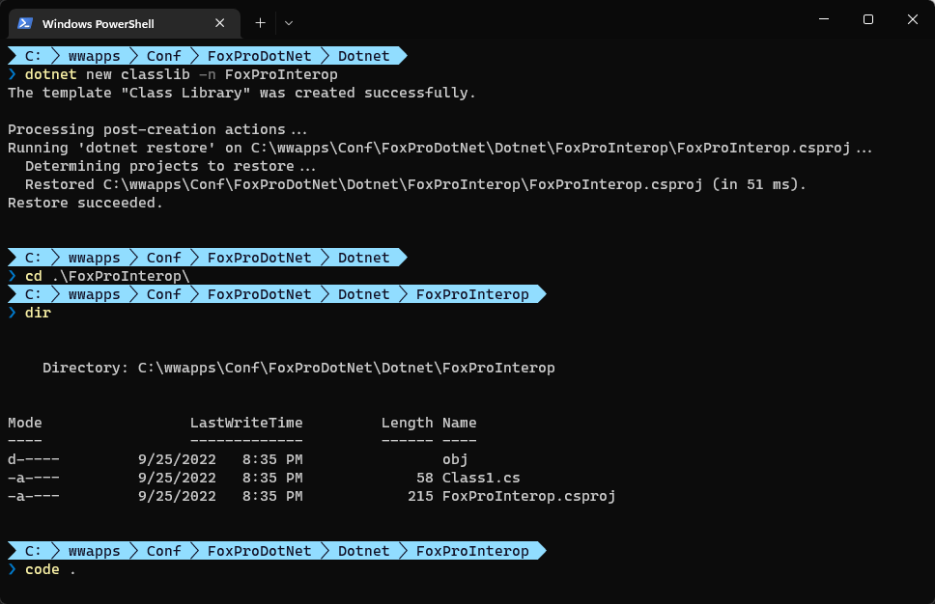
Creating a new .NET Project

Slide 13
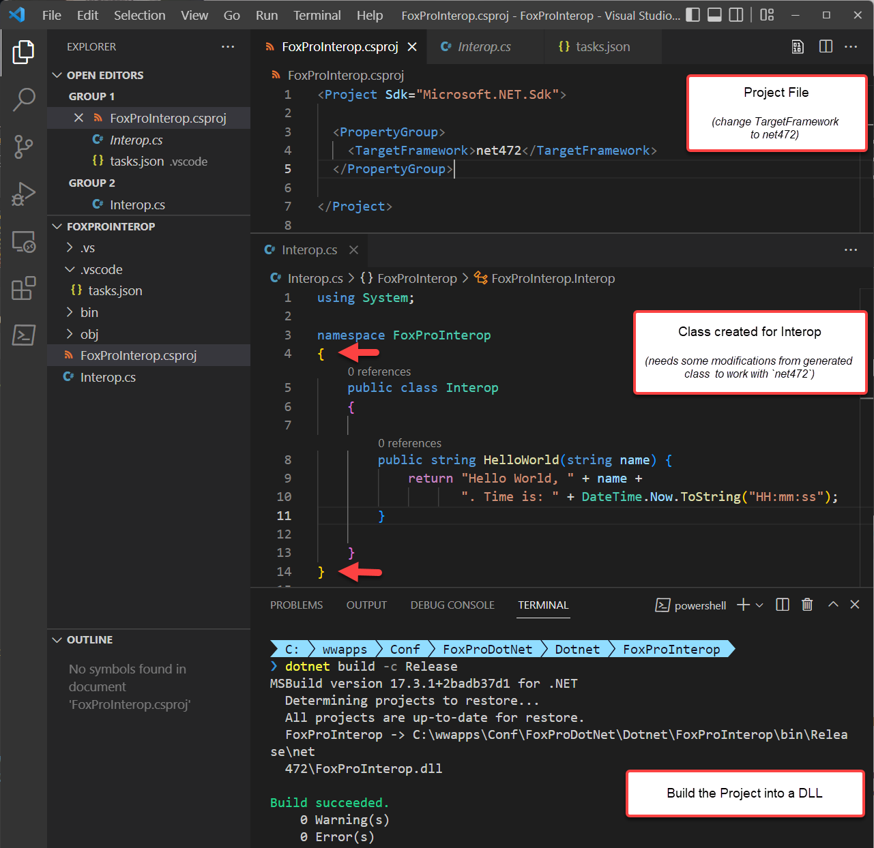
Project in VS Code
VS Code
Light weight editor
Lots of built in syntaxes
C# and .NET Support
For Interop
Modify project target to net472
Remove implicit namespaces
Remove nullability support
Change class to class syntax
Command Line to Build
Use CL to create and build project
Add NuGet packages
Build and Output .NET DLL

Slide 14
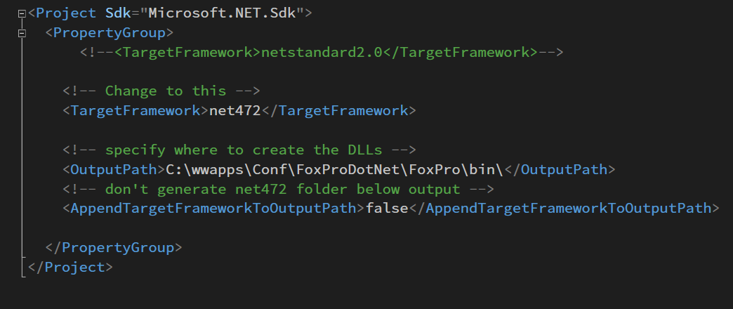
Fixing up the Project File

Slide 15
What about Visual Studio?
Visual Studio is still Large
More focused in recent versions
But still very large to install
Free Community version is Professional
Don’t create a .NET 4.72 Project
Old style projects are super verbose
Don’t support command line builds
Create .NET Core Class Library
Choose whatever version is latest
Then change TargetFramework to `net472`
Remove implicit namespaces and nullable
Remove generated class and create new class
Visual Studio Benefits
Better code completion and code tools
Much better Code Navigation
Optimized Build, Fix, Debug dev cycle
Ability to easily debug from FoxPro into .NET

Slide 16
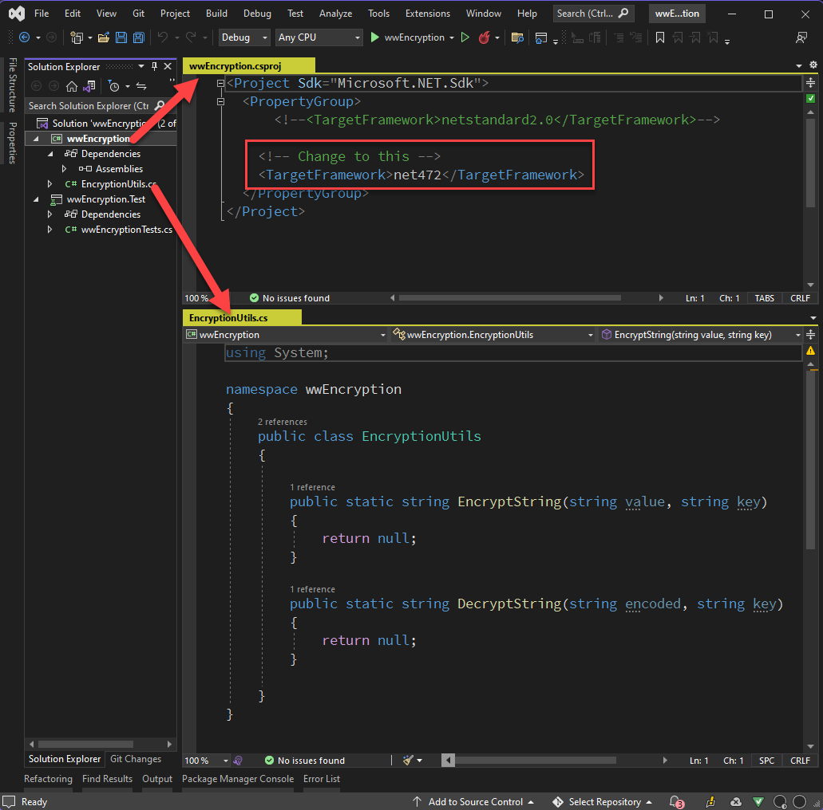
Create a Project in Visual Studio
Create New .NET Project
C# Class Library for .NET Core/Standard
Target .NET Standard 2.0
Modify Project
Change TargetFramework
Change to: net472
Create your .NET Class
Rename or remove Class1.cs
Use descriptive class name
Referenced from Fox: namespace.class
Don’t use same namespace as class!

Slide 17
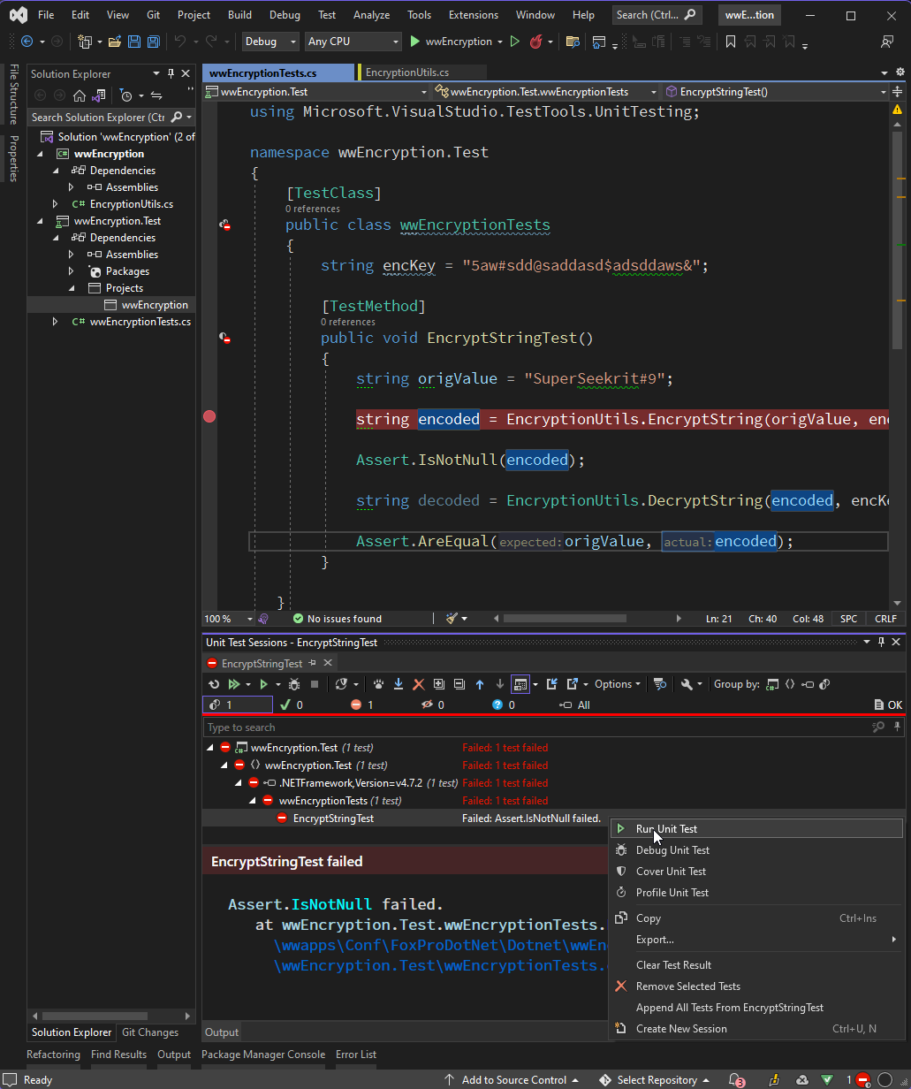
Create a Test Project
Why a Test Project?
Classlibrary can’t be run directly
Easy to test many methods
Makes for good usage documentation
Create Test Project
Add a new C# MsTest Project
Target lowest version available (net50)
Add a project reference to Classlibrary
Rename or delete Class1.cs
Create your Test class
Use [TestClass] and [TestMethod]
Asserts to verify logic
Exceptions fail tests
Run Tests
In the IDE
From Command Line (dotnet test)

Slide 18
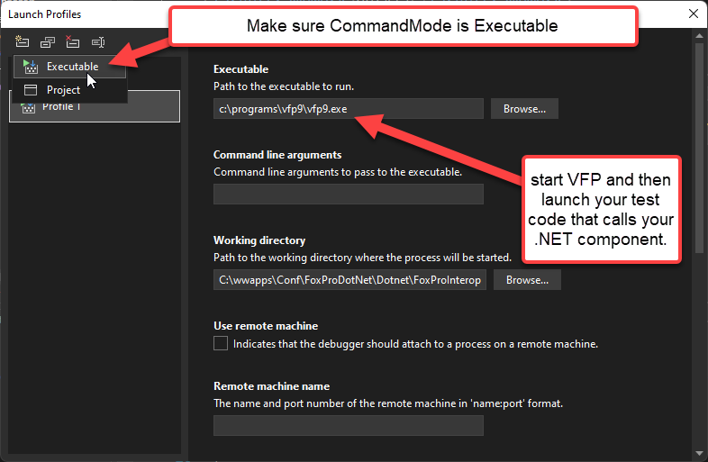
Debugging (1)
Recommend Visual Studio
Use Debug Launch Profiles
Set Mode to Executable
Specify VFP9.exe as start
Start Debug in Visual Studio
Run your test code that calls the .NET component
Code stops on breakpoint
You can then step through

Slide 19
Debugging (2)

Slide 20
Real World Use Cases
Putting .NET into FoxPro Applications

Slide 21
West Wind Web Connection
Integration Libraries
Use .NET Components to extend core Web and Development tools
Integration with built-in .NET features
Integration with third party libraries
Most use wrapper classes to hide .NET from FoxPro
Specific Examples of Built-in integrations
wwSMTP email client via built-in SmtpClient
String, UTF-8 and Unicode helpers
Specific Examples of Third Party Integrations
JSON parsing using JSON.NET
Markdown rendering via MarkDig
SFTP Support via SSH.Net
Web Server Interfaces
Web Connection ASP.NET Module IIS Connector
Web Connection .NET Core self-contained Web Server

Slide 22
Html Help Builder
Integration Libraries
Use .NET Components to extend core Web and Development tools
Integration with built-in .NET features
Integration with third party libraries
Most use wrapper classes to hide .NET from FoxPro
Library Integrations
Markdown rendering using MarkDig
JSON Parsing for configuration files using JSON.NET
HTML Parsing for HTML->Markdown conversions
SFTP Uploads using SSH.Net
Custom Integrations
Create custom .NET class using Reflection to parse .NET Libraries and extract Documentation
Custom .NET Executables (exes)
External Screen Capture Executable that allows capturing windows
Standalone Help Builder CLI Console

Slide 23
Library Exposure
Expose .NET Functionality with a Foxpro Wrapper
wwSmtp
wwMongoDb
wwEncryption

Slide 24
.NET Interop Must Have Tools
.NET Disassembler
Examine .NET types, members etc.
Reflector (v6 free, newer commercial)
DotPeek (free)
JustDecompile (free)
LinqPad – The Command Line for .NET
Test .NET Code Snippets
Great for experimenting with .NET
Has IntelliSense to discover interfaces
Use to run .NET code before accessing with wwDotNetBridge
LinqPad 5 for .NET Framework, Latest for .NET Core (v7)

Slide 25
Thank you!
Resources
Github: Source Code, White Paper and Slides https://github.com/RickStrahl/VirtualFoxFest2022-FoxProDotnet
Contact Rick
@RickStrahl on Twitter
https://weblog.west-wind.com – general blog
https://west-wind.com/wconnect/weblog/ - Fox blog
https://support.west-wind.com - support message board
https://github.com/RickStrahl - GitHub Projects
rstrahl@west-wind.com

